Slide 1
Chronic Kidney Disease : complex cases
Martha Cannon BA VetMB DSAM(Fel) FRCVS
RCVS Specialist in Feline Medicine
Oxford Cat Clinic

Slide 2
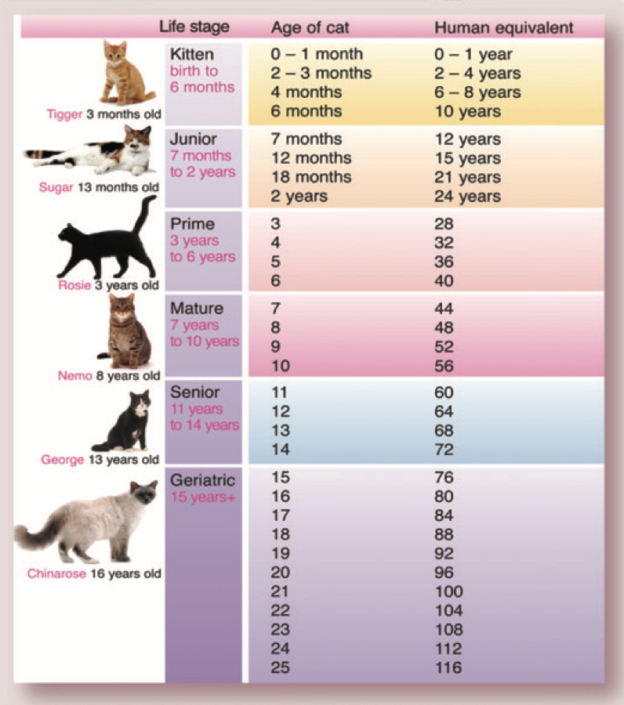
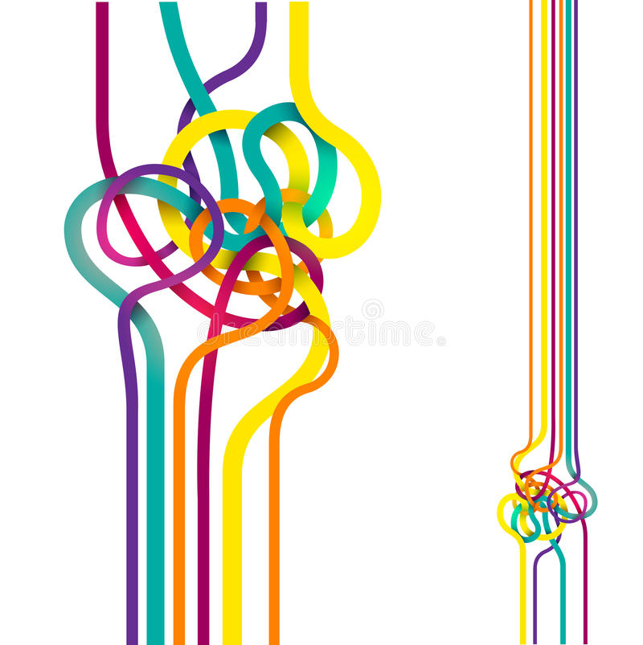
ISFM / AAFP feline life stages
Injuries, ailments
Chronic diseases
Multiple comorbidities

Slide 3
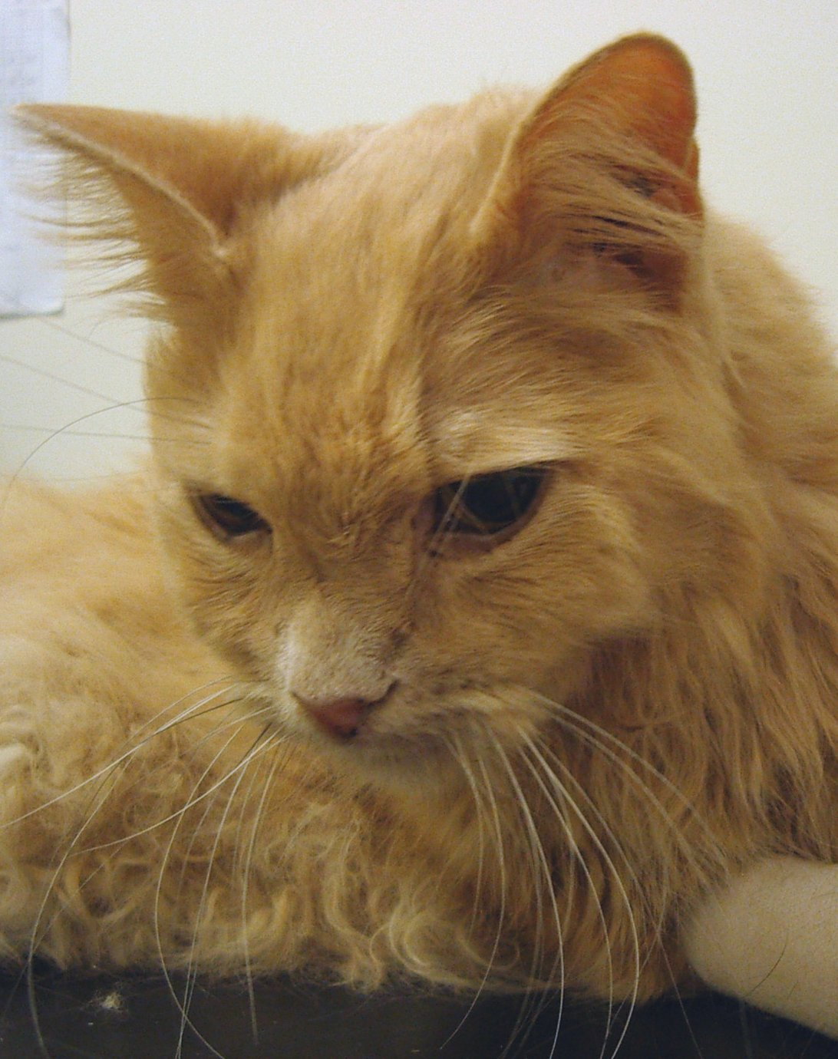
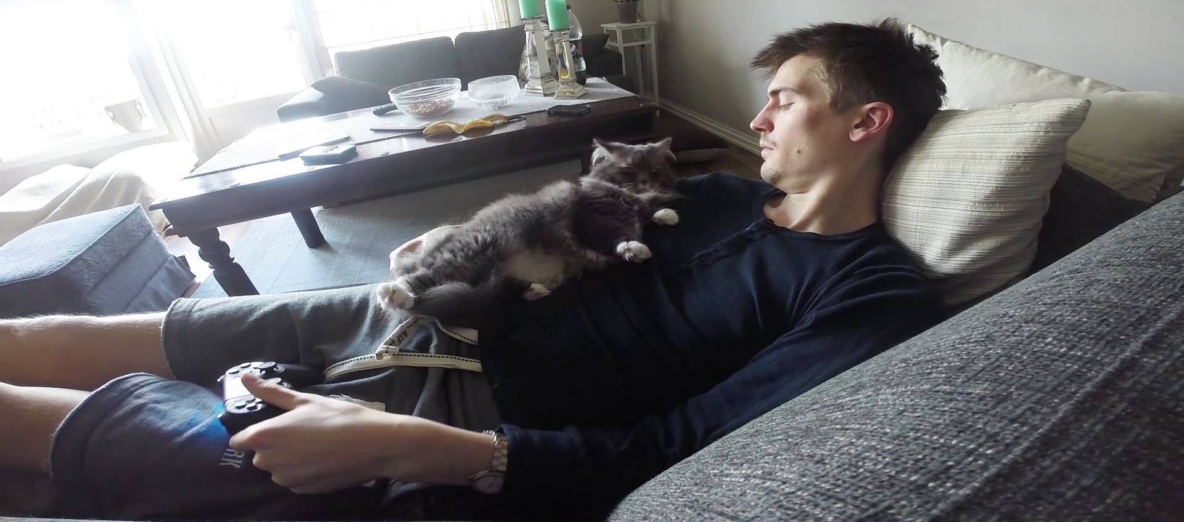
Geriatric Cats: Multiple Conditions
Goblin
Kidney Disease
Weight loss
Poor appetite
Constipation
Anaemia
Arthritis
Goals and Priorities
Cat’s Concerns
Factors affecting quality of life
Factors contributing to progression of disease / development of new diseases
Negative effect on quality of life
Negative impact on longevity
Owner’s Concerns
Signs or behaviour changes that are worrying them
Signs or behaviour changes that are impacting on the family’s quality of life
Cost of treatment / diet / care
Stress of treatment

Slide 4
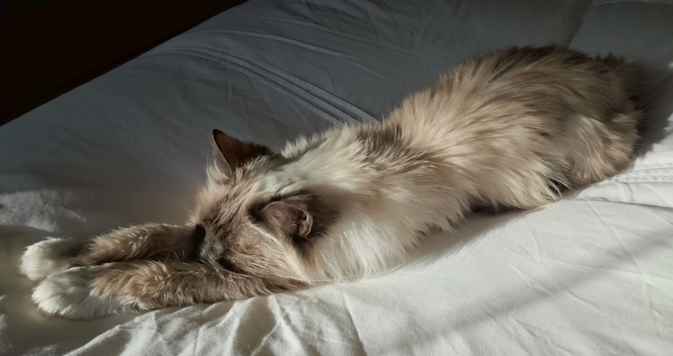
Geriatric Cats: Multiple Conditions
Goals and Priorities
Appetite / Food intake / Bodyweight
Hydration
Analgesia
Environment / Behavioural Needs

Slide 5
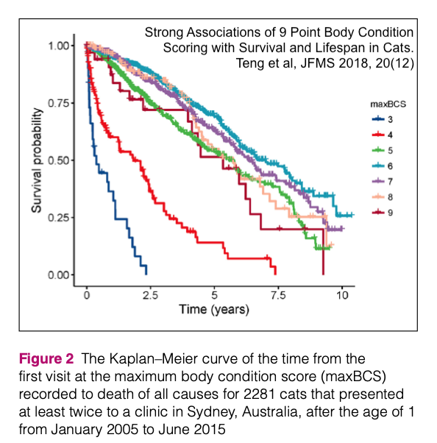
Weight loss in older cats
Cachexia
Weight / Muscle loss associated with disease
Sarcopenia
Gradual loss of lean body mass (LBM) in healthy older animals
Muscle wasting: Common in older cats.
Reduced ability to digest and absorb protein and fat
Muscle atrophy from inactivity, often due to joint pain
Inappropriate dietary recommendations?

Slide 6
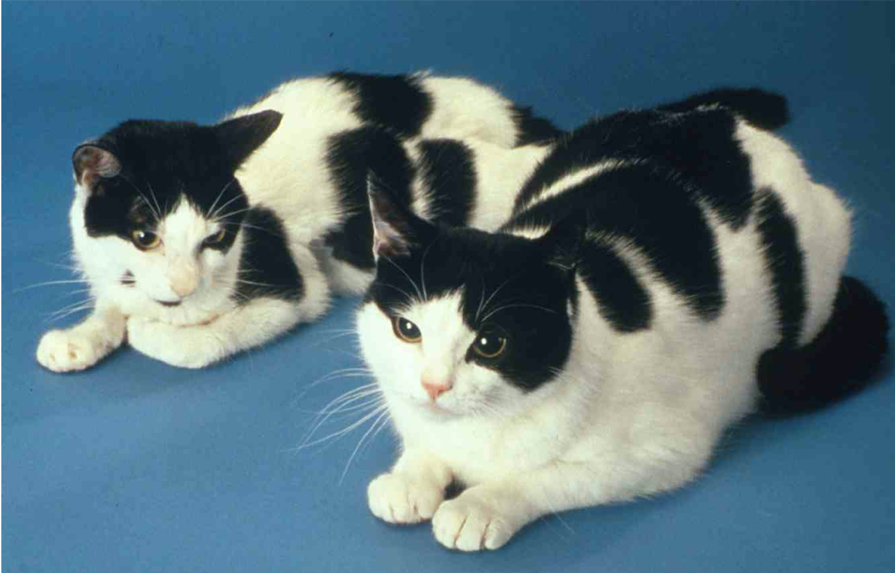
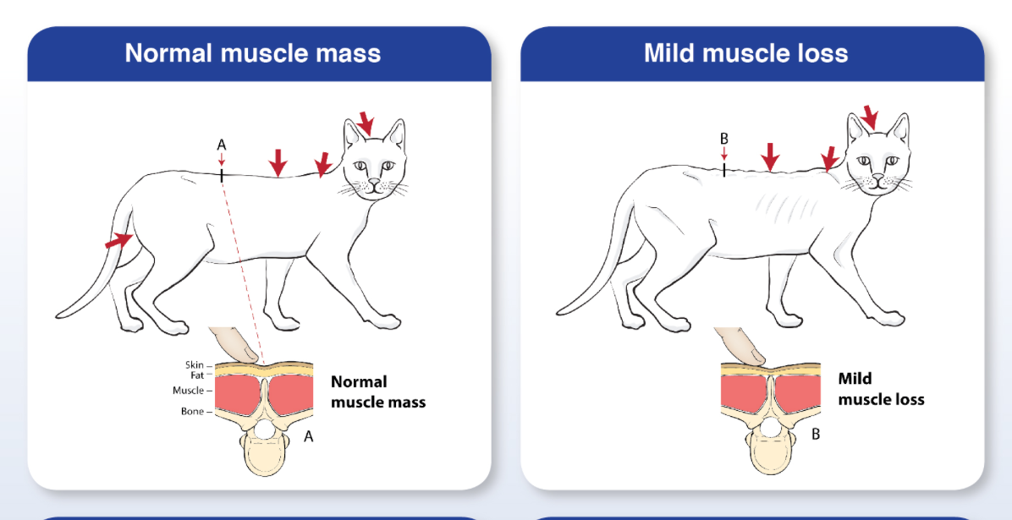
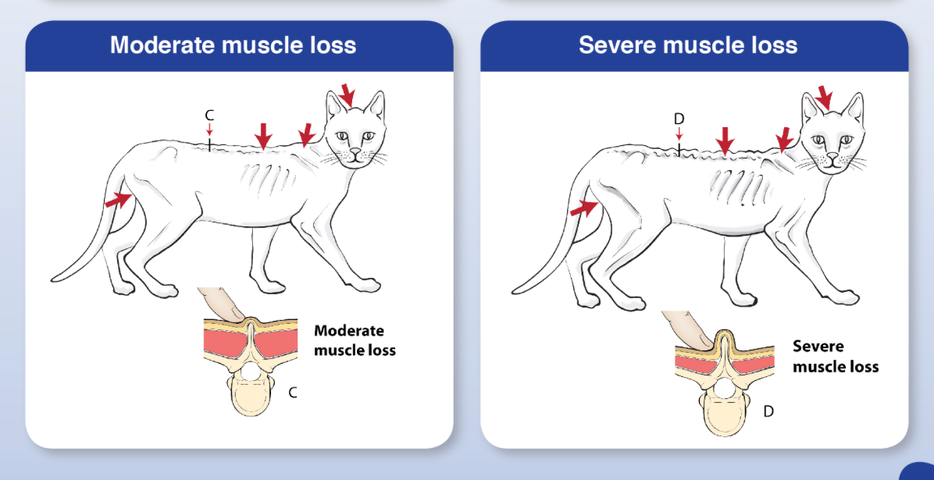
Weight loss in older cats
Bodyweight
Body Condition Score
Assesses amount of body fat
Loss of muscle can occur without fat loss.
Cats can have BCS > 3 but have significant loss of LBM
Muscle Condition Score

Slide 7
Goblin: 14 y/o FN DLH
Chronic Kidney Disease
Owner’s Concerns:
Poor appetite
Progressive weight loss
Withdrawn and lethargic behaviour
Considering euthanasia due to current poor quality of life and irreversibly progressive disease

Slide 8
Goblin: 14 y/o FN DLH
Current Management Advice
Feed renal diet
Poor appetite
Not enjoying renal diets
Owner offering other foods
Owner feeling guilty because not feeding the “right” diet
Physical abnormal findings
Resents handling
Poor coat
Poor body condition + muscle wasting
BCS 2/5, severe muscle loss
Poor skin turgor
Small firm irregular kidneys
Small very firm faecal boluses ++

Slide 9
Goblin: 14 y/o FN DLH
T Prot 77 (60-80 g/l)
Alb 46 (25-45 g/l)
Glob 31 (25-45 g/l)
Urea 19 (2.5-9.9 mmol/l)
Creat 233 (20-177 μmol/l)
Phos 1.6 (0.9-2.2 mmol/l)
Ca 2.7 (2.0-3.0 mmol/l)
ALT 38 (< 60 iu/l)
AlkP 49 (< 60 iu/l)
Gluc 6.9 (3.0-8.0 mmol/l)
Na 155.8 (145-157 mmol/l)
K 3.7 (3.5-4.5 mmol/l)
Total T4 12 (19-64 nmol/L)
Urine SG 1.024 (>1.030)
UP:C 0.03 No active sediment
PCV 21% (25-45)
RBC 4.69 (5.5-10x10¹²/l)
Hb 6.8 (8-15 g/dl)
MCHC 30 (30-35 g/dl)
MCV 42.4 (40-55fl)
WBC 16.0 (5.5-22 x 10⁹/l)
Neuts 12.2 (2.5-13.2 x 10⁹/l)
Lymphs 2.5 (1.5-7.0 x 10⁹/l)
Monos 0.3 (< 0.9 x 10⁹/l)
Eosins 1.0 (< 2.0 x 10⁹/l)
Plts 346 (300-700 x 10⁹/l)
Comment: Red cells are normocytic normochromic. Reticulocytes absent
sBP 110 mmHg (Aim < 160 mmHg in CKD)

Slide 10
Goblin: 14 y/o FN DLH: IRIS stage 2 CKD
Owner’s Problem List
Poor appetite, won’t eat “right” diet
Progressive weight loss
Withdrawn and lethargic behaviour
Toileting outside the litter tray
First Priorities
Appetite / Food intake / Bodyweight
Hydration
Analgesia
Environment / Behavioural Needs
Veterinary Problem List
Poor appetite
BCS 2/5, severe muscle loss
Dehydration
Constipation
Dental disease
Likely arthritis
Anaemia
UTI
Relative Hyperphosphatemia

Slide 11
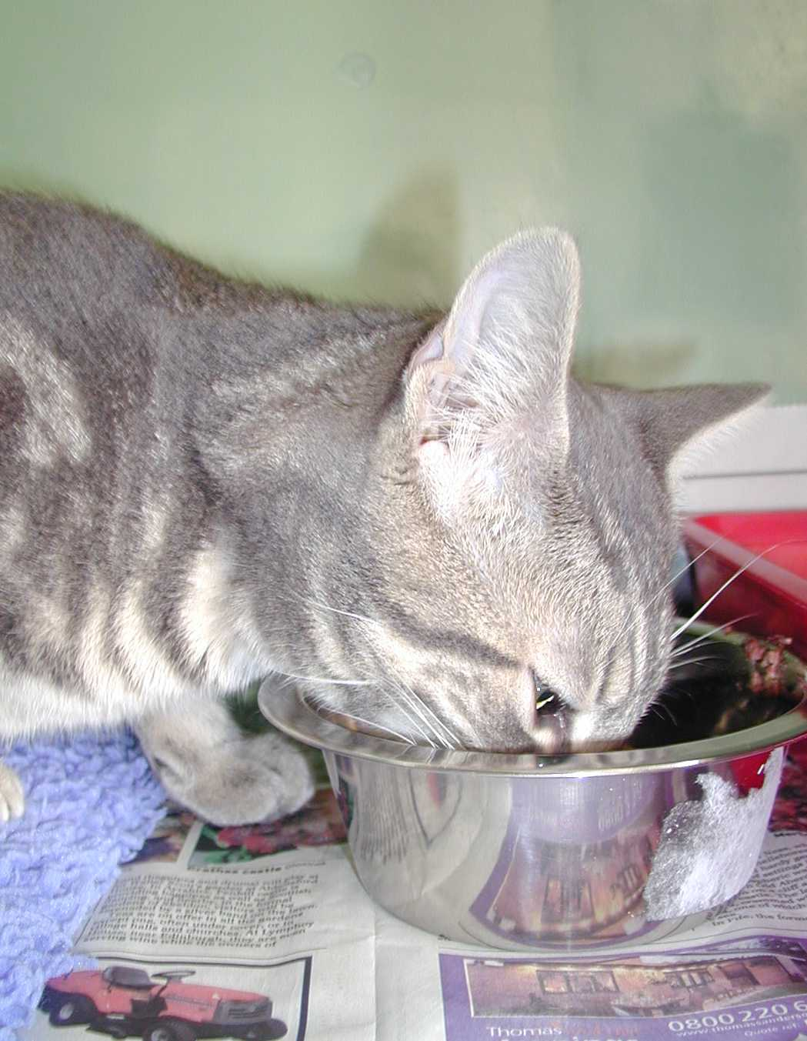
CKD Treatment Priority No 1
Get Them Eating, Then Keep Them Eating
Poor appetite reflects nausea, azotaemia, dehydration, pain
Poor food intake causes weight loss, dehydration, azotaemia, hypokalaemia, anaemia, weakness... ... misery
Loss of LBM contributes to progression of kidney disease

Slide 12
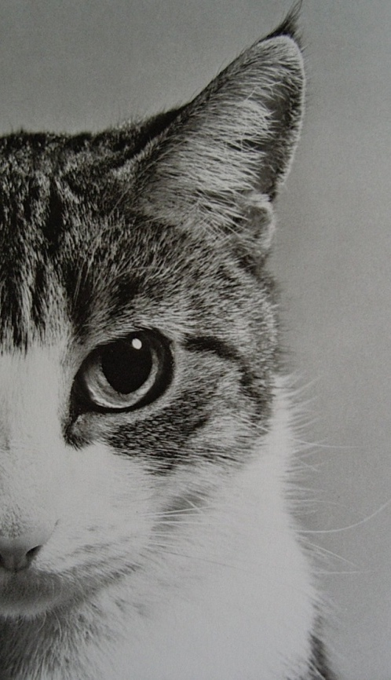
Improving Appetite in ckd
Fluid Balance
Dehydration ⇨ nausea, poor appetite, pain, reduced renal perfusion
Manage Nausea
Analgesia
Manage other concurrent disease
Constipation, UTI, arthritis, dental disease
Anti-acids?
Appetite Stimulant – if still needed

Slide 13
CKD Treatment Priority No 1
Maintain good hydration
Polyuria ⇨ polydipsia
Inadequate compensatory polydipsia ⇨ dehydration
Inappetence ⇨ reduced oral fluid intake
Cats “expect” to get most of their fluid intake from their food
Cat’s Brain says “Not hungry = Not in need of fluid”
Dehydration:
Increased clinical signs, nausea, pain
Reduced renal perfusion ⇨ reduced renal function

Slide 14
improve fluid balance
Clinically detectable dehydration ≥ 5%
I/V fluids indicated, if owner amenable
Subclinical dehydration
Oral fluids
Wet food, tasty fluids, increased number of water bowls etc.
Subcutaneous fluids
In clinic, or at home
80-150 mls per time, 2-3 x per week, or more if needed

Slide 15
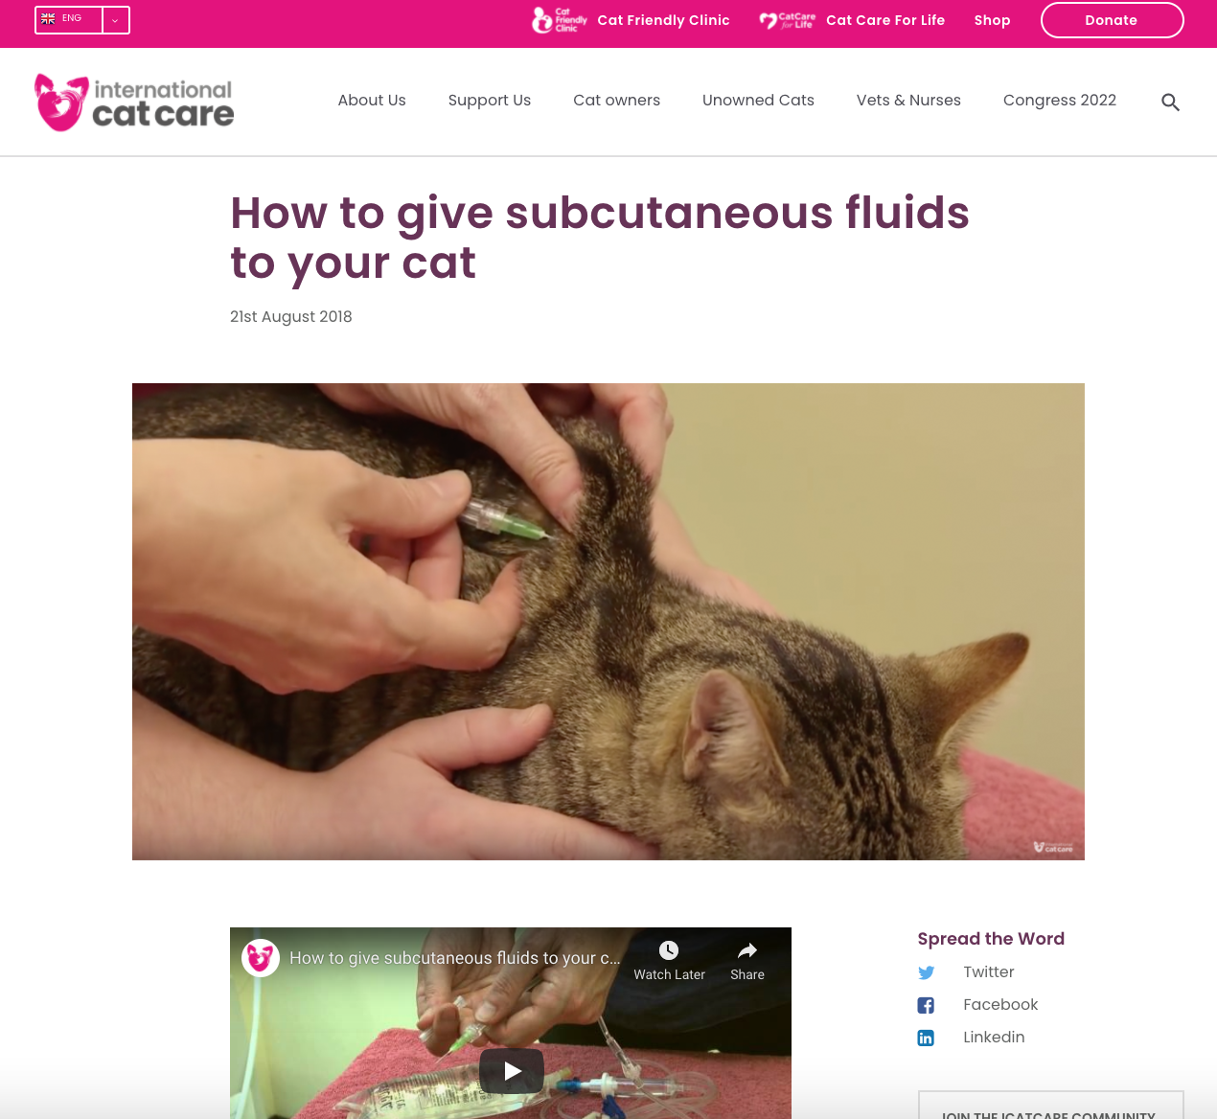
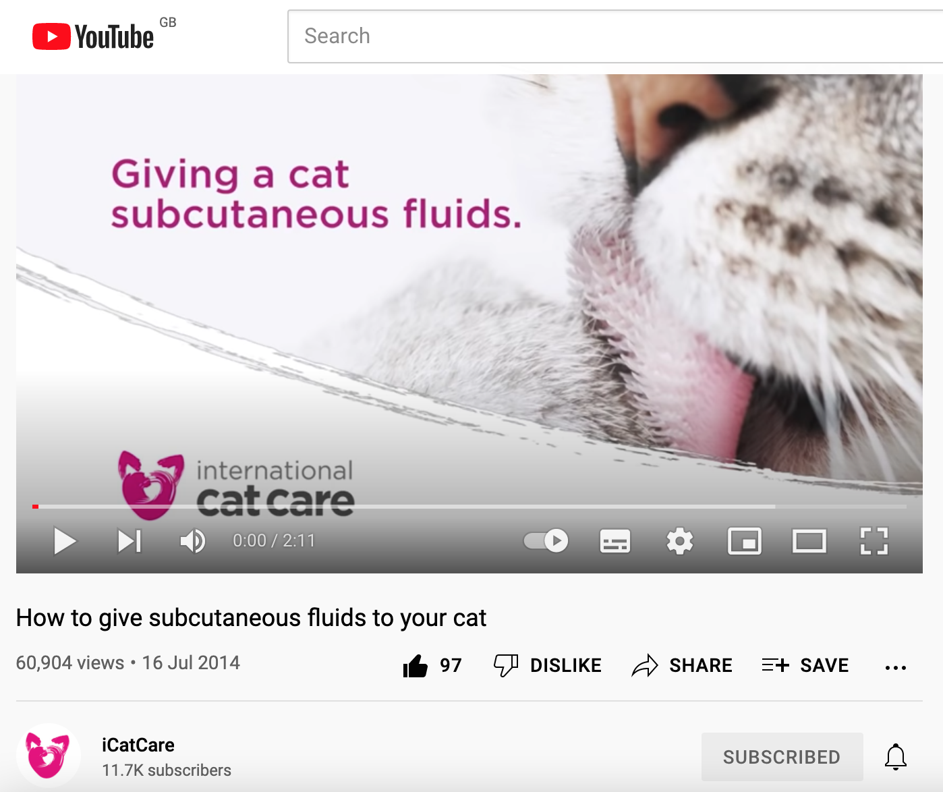
www.iCatCare.org/advice
You Tube - iCatCare

Slide 16
Improving Appetite in ckd
Fluid Balance
Dehydration ⇨ nausea, poor appetite, pain, reduced renal perfusion
Manage Nausea
Analgesia
Manage other concurrent disease
Constipation, UTI, arthritis, dental disease
Anti-acids?
Appetite Stimulant – if still needed

Slide 17
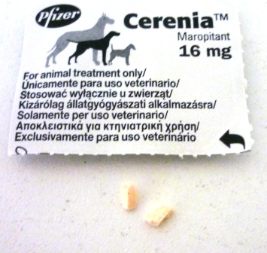
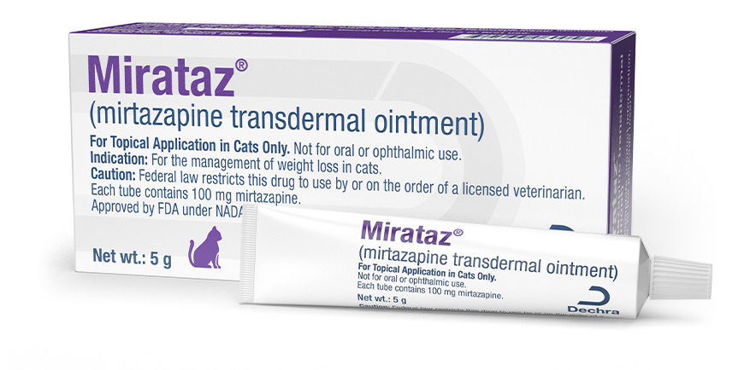
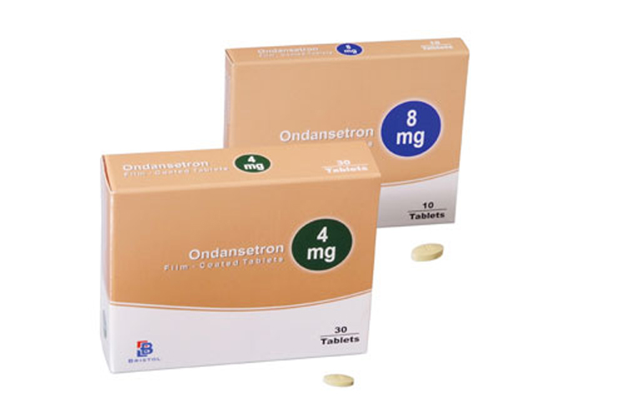
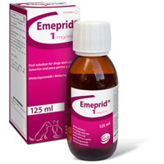
Anti-nausea medications
Maropitant (Cerenia; Zoetis), 4 mg p/o once daily (1/4 tablet)
Central and peripheral activity
Long term use:
Daily dosing, or every other day if effect is adequate
Mirtazapine: 2 mg per cat, every other day if CKD
Anti-nausea: Appetite stimulant
Long term use
Ondansetron: 2 mg p/o twice daily (1/2 tablet)
HT3 antagonist
Effective and well tolerated. Not licensed for veterinary use
(Metoclopramide)
(Little anti-nausea effect in cats)

Slide 18
Improve Appetite
Fluid Balance
Manage clinical and subclinical dehydration
Manage Nausea
Mirtazapine
Maropitant, Ondansetron
Analgesia
Manage Constipation
Anti-acids?
Omeprazole 1 mg/kg twice daily
Appetite Stimulants
Mirtazapine, Cyproheptadine:

Slide 19
Goblin: 14 y/o FN DLH: IRIS stage 2 CKD
Owner’s Problem List
Poor appetite, won’t eat “right” diet
Progressive weight loss
Withdrawn and lethargic behaviour
First Priorities
Appetite / Food intake / Bodyweight
Hydration
Analgesia
Environment / Behavioural Needs
Veterinary Problem List
Poor appetite
BCS 2/5, severe muscle loss
Dehydration
Constipation
Likely arthritis
Anaemia
Hyperphosphataemia

Slide 20
Goblin: 14 y/o FN DLH: IRIS stage 2 CKD
Analgesia
Right Now:
Buprenorphine: i/v or oral (not licensed)
Pain of dehydration, pending rehydration
Alleviate pain when squatting and straining
Arthritis – short term management
Later on:
Long term treatment plan to manage chronic pain from arthritis

Slide 21
Goblin: 14 y/o FN DLH
Owner’s Problem List
Poor appetite, won’t eat “right” diet
Progressive weight loss
Withdrawn and lethargic behaviour
Toileting outside the litter tray
First Priorities
Appetite / Food intake / Bodyweight
Hydration
Analgesia
Environment / Behavioural Needs
Immediate Treatment Plan
Mirtazapine: 2 mg daily / every other
Transdermal, less stress for owner and cat
Feed her what she wants to eat
Subcutaneous fluids
Buprenorphine: 0.1 ml/kg twice daily

Slide 22
Constipation
Common in elderly cats
CKD / poor appetite => Dehydration => dry faeces
Hind-limb muscle loss => reduced ability to squat to defaecate
Concurrent DJD => discomfort when squatting to defaecate

Slide 23
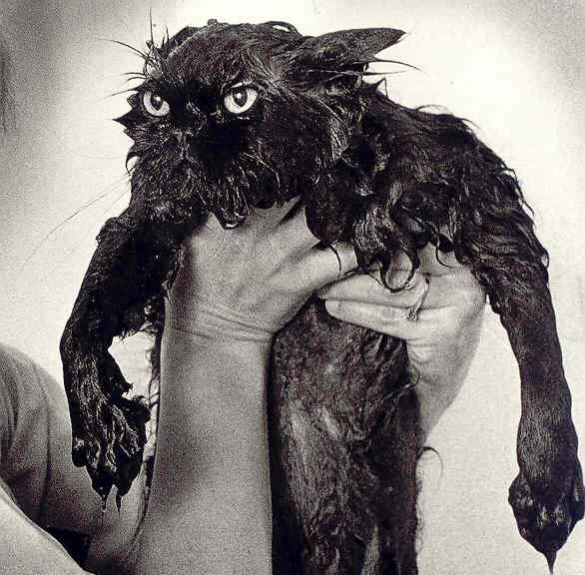
Constipation in elderly cats
Principle problem is dehydration
Oral fluids
Wet food, tasty fluids, increased number of water bowls etc.
Subcutaneous fluids
In clinic, or at home
80-150 mls per time, 2-3 x per week or daily if needed

Slide 24
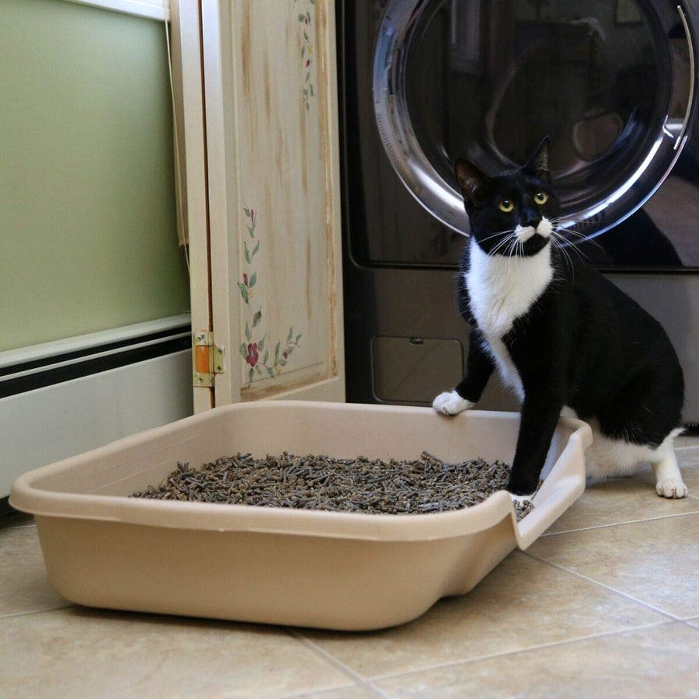
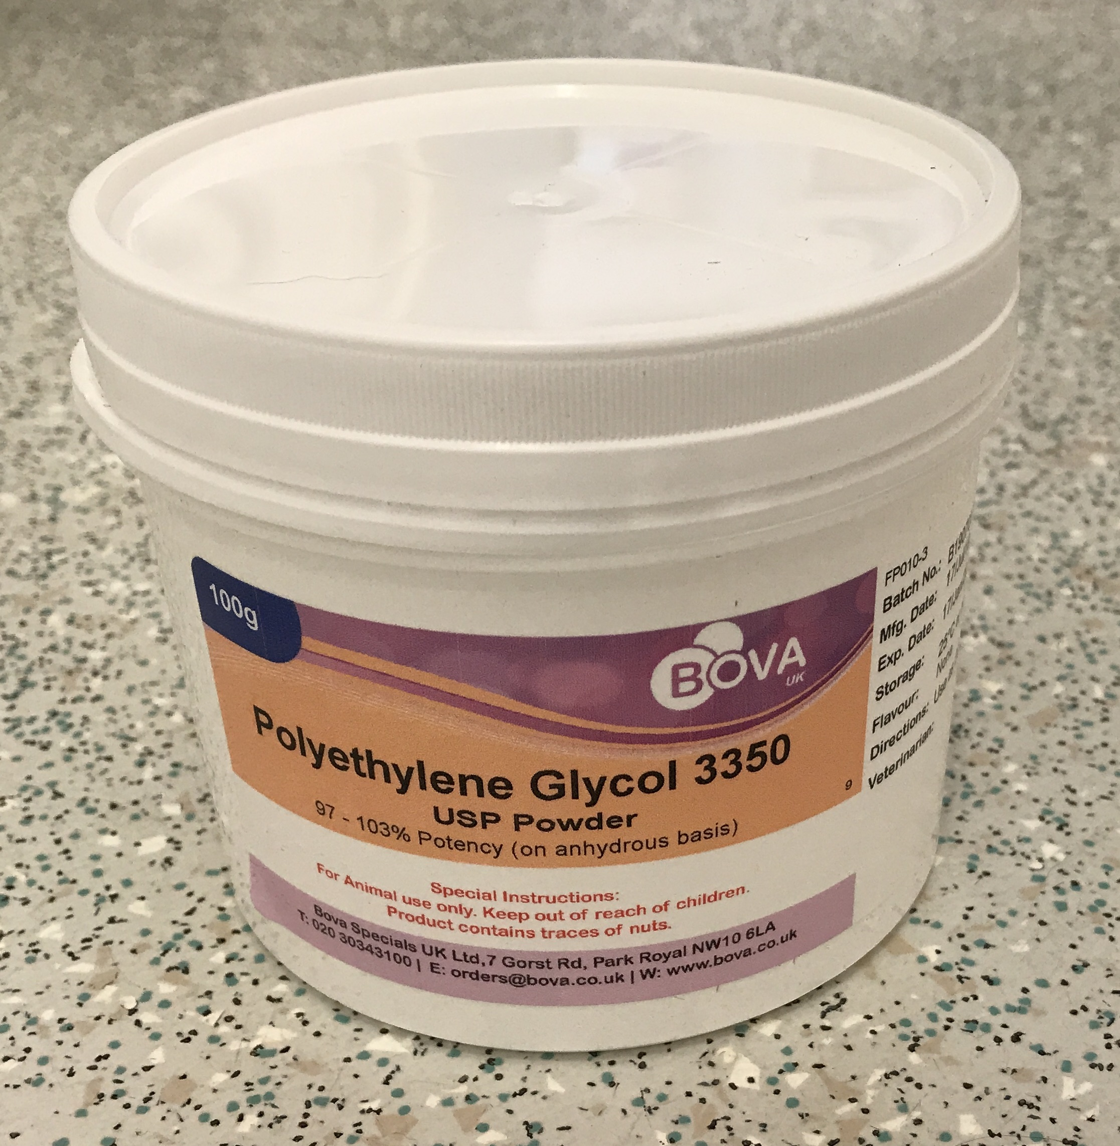
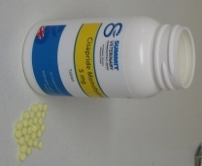
Constipation in elderly cats
Maintain Hydration: oral fluids, s/c fluids
Easy Access to Low Sided Litter Tray
Address pain of arthritis
Stool Softeners: Lactulose, PEG powder
Ensure good hydration
Lubricant laxatives: Flavoured paraffin waxes, liquid paraffin (in food)
Cisapride; 0.5–2 mg/kg p/o bid

Slide 25
Goblin: 14 y/o FN DLH
Owner’s Problem List
Poor appetite, won’t eat “right” diet
Progressive weight loss
Withdrawn and lethargic behaviour
Toileting outside the litter tray
First Priorities
Appetite / Food intake / Bodyweight
Hydration
Analgesia
Environment / Behavioural Needs
Immediate Treatment Plan
Mirtazapine: 2 mg daily / every other
Transdermal, less stress for owner and cat
Feed her what she wants to eat
Subcutaneous fluids
Buprenorphine: 0.1 ml/kg twice daily
Paraffin Wax lubricant
PEG powder in food once she is eating well

Slide 26
Goblin: 14 y/o FN DLH
5 days later: Re-examine
Good improvement
Brighter and more active, interacting more with the family
Eating supermarket brand wet food
No known episodes of inappropriate urination
Passed good amount of faeces, in the litter tray
Physical Examination
Easier to handle, appears more comfortable
Weight improved (rehydration)
Less faecal material in colon
As Before: Poor skin turgor, poor coat, underweight, small firm irregular kidneys, dental disease
Owners no longer contemplating euthanasia

Slide 27
Goblin: 14 y/o FN DLH
Veterinary Problem List
Poor appetite
BCS 2/5, severe muscle loss
Dehydration
Anaemia
Constipation
Likely arthritis
Long term treatment plan
Maintain appetite and feed for weight gain
Maintain good hydration
Manage Anaemia
Introduce stool softeners if/as needed
Long term treatment plan for arthritis
Low dose NSAIDs now is eating well
Dental treatment
Ongoing monitoring and managing of CKD

Slide 28
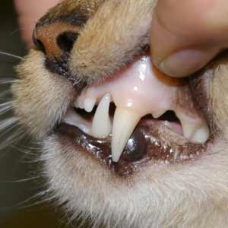
CKD and Anaemia
Causes
Uraemia, chronic disease malnutrition, GI ulceration, iron deficiency,  erythropoietin
Treatment
Control uraemia: maintain good hydration
Maintain adequate nutrition
Vitamin B12
? Anti-acids
Iron injection – if needed
Measure iron and TIBC (calculate Transferrin Saturation)
Erythropoeitin injections: Darbepoeitin (Aranesp)

Slide 29
Arthritis in Cats
How common is arthritis in cats > 12 y/o?
Less than 25% are affected
25-50% are affected
50-65% are affected
More than 65% are affected
Under-recognised disease
More subtle presentation than in dogs
Very subtle changes on examination
Cats adapt there lifestyle in response to chronic pain:
Reduced activity
Reduced grooming
Reduced hunting / playing
Reduced interaction
Short-temper / “grumpy”
Considered to be signs of “old age”

Slide 30
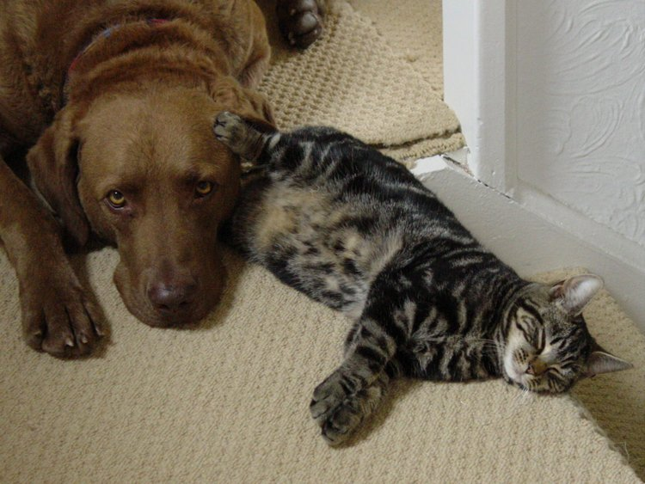
Arthritis in cats
NSAIDs
Anti-NGF Monoclonal Antibodies
Pentosan polysulphate injections (Cartrophen)
Gabapentin
Buprenorphine
Tramadol
Nutraceuticals
Prescription diet
Acupuncture
Hydrotherapy

Slide 31
Environmental modification
Provide soft easily accessible beds
Place beds in quiet, draft free areas of the house
Igloo beds or cardboard boxes - warm and secure
Provide steps or ramps to higher sites
eg, the sofa, the cat flap or raised feeding sites
Provide an indoor low-sided litter tray
Use different types of litter that are softer for sore feet
Notes:
30 MINS

Slide 32
Non-steroidal anti-inflammatory drugs
Meloxicam and Robenacoxib
Both licensed for long term use
Very good compliance
Use with care in cats with renal compromise
NSAIDs do not cause kidney damage
Gowan RA et al (2011) JFMS 13(10):752-61
Unless – cat is in a prostaglandin dependant state
Dehydration (inappetence), Hypotension

Slide 33
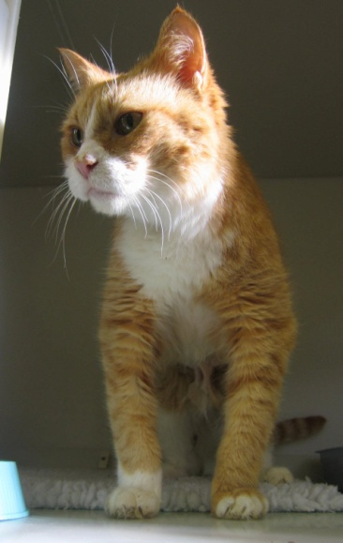
NSAIDS and Chronic kidney disease
Key Points
Only use in cats with stable CKD
Not off food
Not dehydrated
Advanced CKD – support with s/c fluids
Minimum effective dose
Use environmental modification and adjunctive treatments as needed to minimise the dose
Nutraceuticals, gabapentin, acupuncture etc...

Slide 34
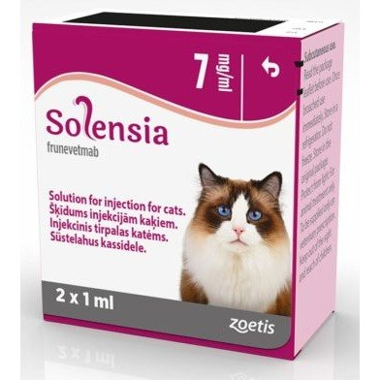
FELINE ARTHRITIS:
Solensia; Zoetis - Anti-Nerve Growth Factor (NGF) Monoclonal Antibody
NGF is elevated in arthritic joints
Neutralising NGF
Relieves pain
Reduces release of pro-inflammatory mediators
Reduces release of NGF
Monoclonal Antibodies: Minimal adverse effects
Highly specific to the target molecule
Metabolised via protein degradation pathways – minimal involvement of liver and kidneys
Subcutaneous injection, once a month
Notes:
Published 2010

Slide 35
Geriatric Cats: Multiple Conditions
Goals and Priorities
Cat’s Concerns
Factors affecting quality of life
Factors contributing to progression of disease / development of new diseases
Negative effect on quality of life
Negative impact on longevity
Owner’s Concerns
Signs or behaviour changes that are worrying them
Signs or behaviour changes that are impacting on the owner’s / family’s quality of life
Cost of treatment / diet / care
Stress of treatment

Slide 36
Geriatric Cats: Multiple Conditions
Goals and Priorities
Appetite / Food intake / Bodyweight
Hydration
Analgesia
Environment / Behavioural Needs
Keep them Eating
Maintain Bodyweight

